Slide 1
Update Profile
DOCTOR
Set Unavailability
View Appointments (Today, Upcoming)
USER
(Role based registration with common fields)
Automatically cancel
USER
(Login)
Update Profile
Give Feedback
Book Appointment
PATIENT
View Appointments (Today, Upcoming)

Slide 2
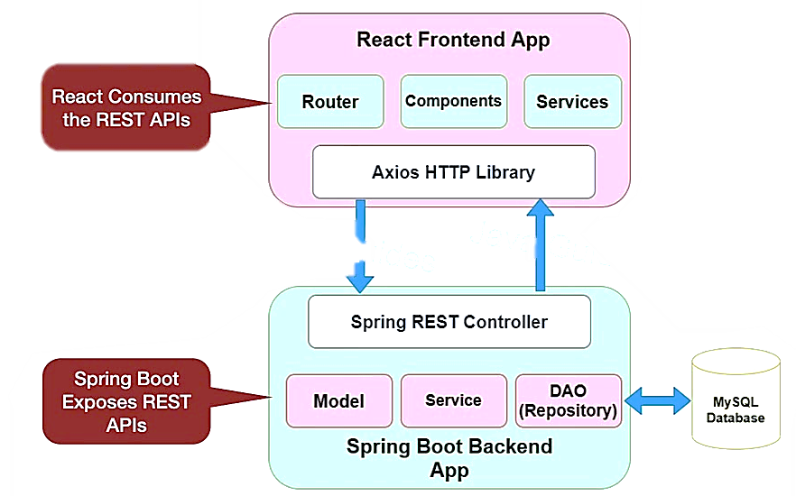

Slide 3
